Slide 1
Examples of Machine Learning with TBFM Data
SWIM Industry/FAA Team (SWIFT) Briefing
February 27th, 2020
Al Capps - Al.Capps@nasa.gov

Slide 2
Objectives
Describe Problem Solving Workflow
  Apply a cross-industry standard collaborative workflow to aviation data mining
Provide Examples
  Demonstrate versatility of analytical solutions via the use of a collaborative workflow in rapid development of two machine learning models on different NAS challenges
Explain Machine Learning as a Service
  Demonstrate how solutions can be rapidly deployed for real-time operations, not just post operations analysis
Obtain required input on a specific problem
  Obtain problem definition clarification information from the aviation community on the ‘High TBFM Delay’ problem mentioned in prior SWIFT meetings
Identify who can meet more frequently for faster progress
  Convey a sense of urgency to work quickly and collaboratively on common analytical aviation needs
Notes:
2:37

Slide 3
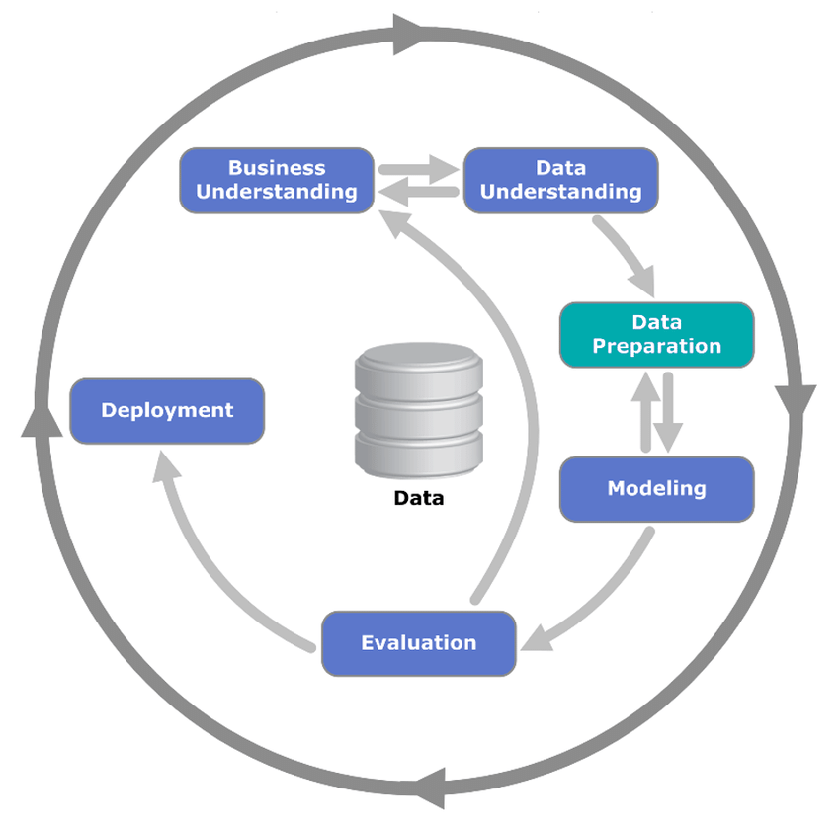



CRISP-DM Process Applied to Aviation
50K Foot View
Variation of CRISP-DM Used by NASA
Identify Operational Goal
Select Initial Data Sources
Evaluation of Model Performance
Data Pre-processing
Deployment to Real-time System
SME
Analyst
Data Understanding
Model Validation
Feature Engineering & Model Fitting
Cross-Industry Standard Process for Data Mining (CRISP-DM)
A key point to providing these two workflows is to highlight the necessity of an iterative workflow between SMEs and Analysts.
Each step is important, and there are experts in each of these workflow areas that can perform these tasks quickly.
Notes:
2:07

Slide 4
Example 1 - Motivation and Operational Goal
Motivation
It may surprise some aviation enthusiasts to learn that at large multi-runway airports in the National Airspace System (NAS), the arrival landing runway is often not known ahead of the actual landing
Knowledge of landing runway can provide benefits:
  Landing time prediction
  Taxi-in time prediction
  Gate Conflict prediction
  Gate resource utilization information (e.g. tugs, etc.)
Goals
Allow operators and ATC systems to identify the most likely landing runway
Provide this service in near real-time, targeting at least 1 hour ahead of landing
Report the accuracy of the predictions provided
Strive for maintainability and scalability across all NAS airports
Identify Operational Goal
Notes:
2:24

Slide 5
Focus on TBFM SWIM Data
TBFM SWIM
  Predicts a landed runway for its own internal processes. This could serve as a useful baseline to assess merit of machine learning comparison.
  Has other attributes/features that may be beneficial to prediction. Tax payers spent significant funding adapting TBFM across the NAS so additional benefit is desirable.
Truth data for actual landed runway
  Controller scratchpad entries provided in TBFM (at some sites)
  Analysis of alternative sources for larger truth data set likely leads to additional data sources that need to be merged with this initial data set.
Select Initial Data Sources
Notes:
4:15

Slide 6
Python Scripts to Create TBFM SWIM “AIR” Dataset
Raw TBFM
SWIM XML Messages
For this presentation, python scripts were created for each step which pull from public TBFM SWIM data. There are many ways to accomplish this in other languages or designs.
Step 1
Flatten XML into CSV and separate messages
Step 1 Output CSV
(AIR,CON, ADP, OTH)
Step 2
Create a daily summary of each TBFM flight using ‘aid’,’tbfmid’,’orig’,’dest’ as unique identifier
Step 2 Output CSV
(AIR Daily Summary)
Step 3
Creates data sets for analytics
Step 3 Output CSV
(all TBFM arrivals, all APREQs, etc.)
Data Pre-processing
Notes:
6:07

Slide 7
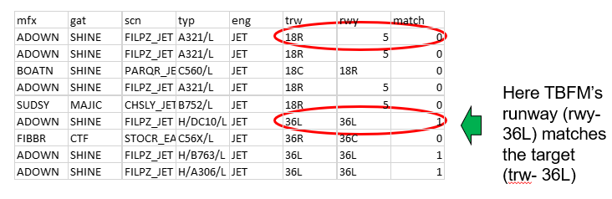
Data Understanding - Description
For a description of the TBFM SWIM data source and its operational context, see
  https://nsrr.faa.gov/nsrr-library-document/9298
  Specifically, section 4.1.1 contains a definition of the data elements used
Of the columns available in TBFM AIR messages, the ones utilized for this work were:
  “trw”- TRACON runway assigned by the controller. This was considered “truth” runway. Note: other sources of runway truth are currently being evaluated, especially given controller scratchpad entries are not available for all airports.
  “rwy” -Runway that TBFM used in its internal model. This was used only to assess TBFM accuracy.
  “dap” – Departure airport
  “apt” – Arrival airport
  “typ” – Aircraft type (although this was later eliminated from modelling)
  “mfx” – Arrival meter fix name as adapted in TBFM.
  “gat” – Arrival gate name as adapted in TBFM.
  “cfg” – The configuration, as listed in TBFM.
  “scn” – Stream class name. This essentially tells TBFM which flights need to be separated from one another.
Data Understanding
Notes:
3:00

Slide 8
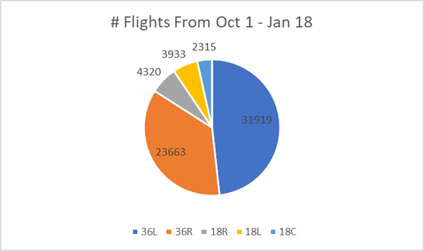
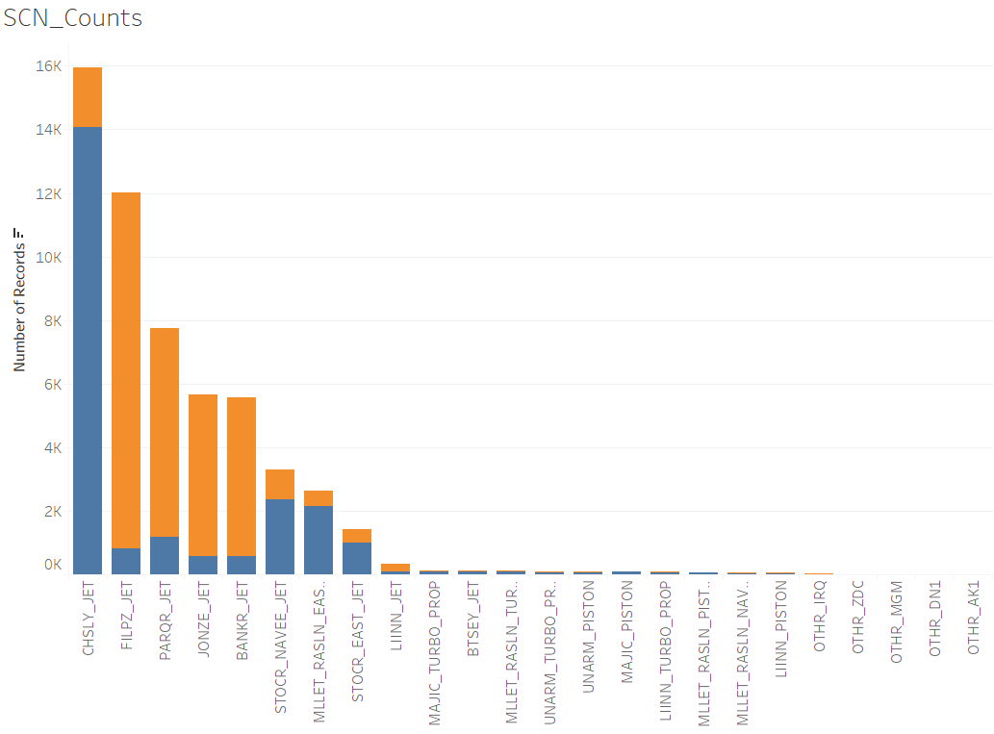
Data Understanding – Sample & Baseline Description
CLT data was used given ATD-2 team’s ability to verify accuracy (available at many other airports)
Data was collected from Oct 1st 2019 through Jan 18th, 2020. Only rows with all required data elements properly populated were kept. With this filtering, 66,165 rows/flights remained for training and test.
Tableau Visualization of SCN by Landed Runway
Given the dominance of North landed runways (36L, 36R), the modelling was specifically developed to focus on this flow direction. This presumes that the configuration, or flow direction, would be passed into any algorithm that would seek to use this modelling.
  With this decision, this becomes a ‘binary classification’ problem
TBFM arrival runway prediction accuracy was approximately 70% accurate to these runways during this time.
  This served as a baseline for the learner to attempt to beat
Data Understanding
Notes:
5:28

Slide 9
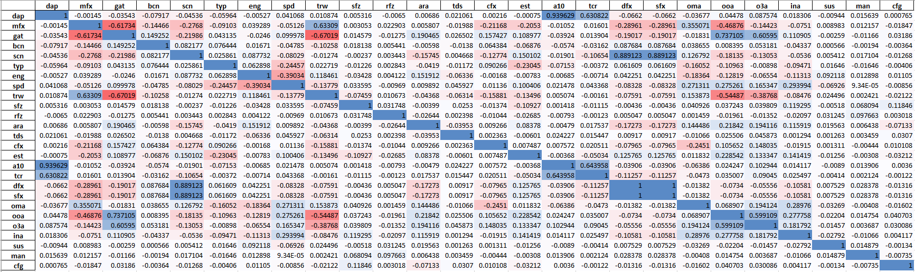

Winnowing Down the Columns/Features Used
Correlation Matrix of Potential Columns/Features to Evaluate Multicollinearity
Run early models with/without certain features
to determine if they are beneficial/required
Here the receiver operating characteristics (ROC) area under curve (AUC) shows that remove the filed flight plan (A10) yields equivalent or better performance.
Some of the notably high correlations are:
A10 vs DAP => .939629
TCR vs DAP => .630822
GAT vs MFX => -.61734
OOA vs GAT => .737105
O3A vs GAT => .60595
DFX vs SCN => .889123
SFX vs SCN => .889123
TCR vs A10 => .643958
SFX vs DFX => 1
O3A vs OOA => .599109
Interestingly, the stream class name (SCN) contains useful information that allows removal of other columns without any loss in performance
Feature Engineering & Model Fitting
Notes:
5:35

Slide 10
How Machine Learning Differs from Classical Programming (50K Foot View)
Classical Programming
Machine Learning
Classical Programming
(i.e. - writing code)
Answers
Machine Learning
Rules
Answers
Rules
Data
Data
The rules that machine learning automatically creates are applied to new data points to provide new answers.
Notes:
3:33

Slide 11
Initial Models to Assess How Well Commonly
Used Techniques Will Work with this Dataset
8 initial binary classification models were evaluated on the dataset
  Naïve Bayes
  Linear regression Model
  Logistic regression
  Fast Large Margin
  Deep Learning
  Decision Tree
  Random Forest
  Gradient Boosted Trees
Gradient boosted trees had the highest accuracy and lowest variance
  This was without any hyperparameter tuning (roughly out-of-the-box models)
  While other models may appear to be close (e.g. within 1%, their performance on other key metrics beyond accuracy underperformed these two learners)
Feature Engineering & Model Fitting
Notes:
2:16

Slide 12
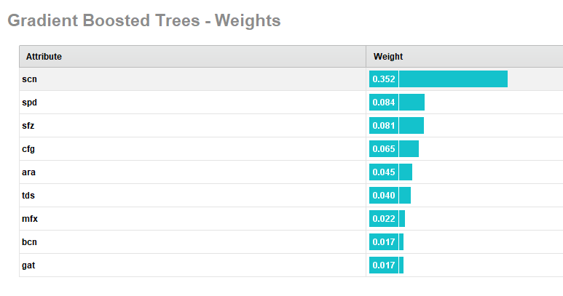
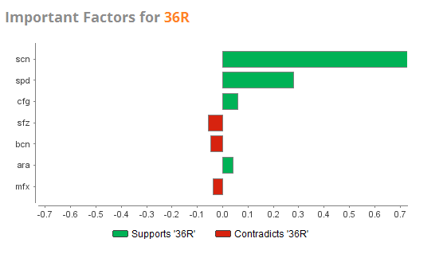
Input Attribute (Feature) Relative Importance
Feature Importance - Overall
Feature Importance – By Runway (target)
Feature importance information from the models were used to continue the winnowing down (reduce dimensions) of the attributes used in the modelling to the most relevant, while also considering new features that would improve performance
Feature Engineering & Model Fitting
Notes:
2:41

Slide 13


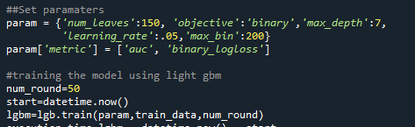
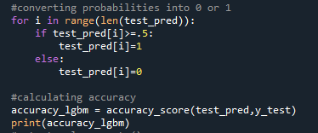
Develop Python Model and Validate
Based on the promising initial results, a Light Gradient Boost (LGBoost) model was developed in python
  LGB has been recently winning a number of the data science competitions due to its ability to evaluate a leaf of the tree without creating an entire branch (better performance)
The steps were:
  Read in the CSV file that came from previous steps into a Pandas data frame
  Create two data frames. One for features, one for truth.
  Create and store interim steps in ModelFamily wrapper class. More on this later.
  Encode variables as required for the Light Gradient boost (LGB) model.
  Split the dataset into train and test.
  Specify initial hyperparameters and train the LGB model on the training dataset.
  Use the trained model to generate new predictions on the test data.
  Measure the performance of the test dataset.
  When satisfied with performance of the model, store/save it for later use.
N-fold validation is a commonly used technique to prevent “over fitting” and create a robust learner that will work well with data it has never seen
Model Validation
Notes:
3:37

Slide 14
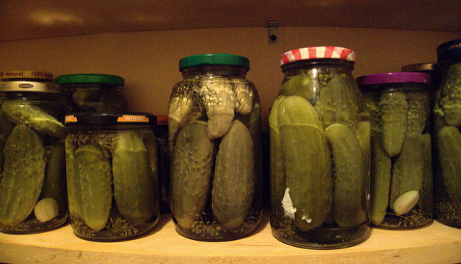
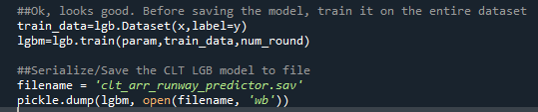

Saving the Model for Later Use in Web Service
The final model was saved/serialized for later use
  In this case, we used ‘pickle’
  This created a 0.5mb file on disk
There are a number of different frameworks to use our new model (as a service).
Deployment options need to consider many factors depending on how the service will be used
  When using the model as a service, you do not need to load the model every request. It can be used efficiently to provide answers just like classical programming services.
  In our case, we use python ‘flask’
Open source python micro-framework to test services
Deployment to Real-time System
Evaluation of Model Performance
Notes:
3:19

Slide 15
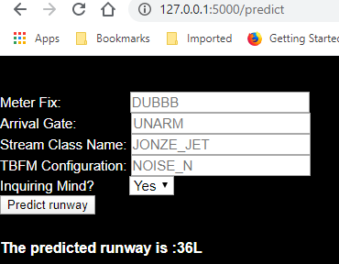
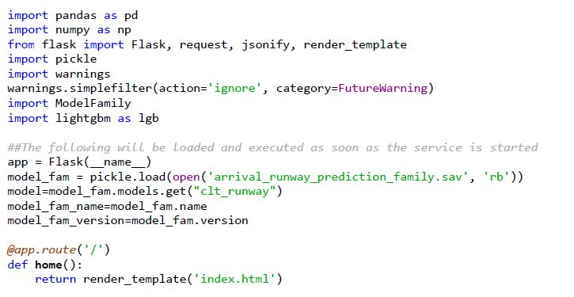
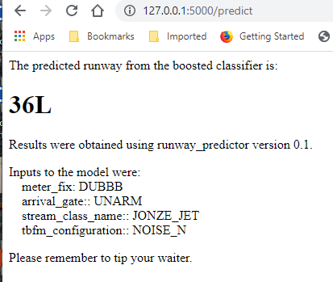
Testing Machine Learning as a Service (MLaaS)
A simple web page was developed that allowed the user to enter the key inputs required by the model
  This was just for test, likely different use in operations
For operational deployment of python consider Heroku or other open source environments
  For the time being, NASA team is likely to stick with python stack instead of predictive markup modeling language (PMML) given complexities/overhead
Deployment to Real-time System
Evaluation of Model Performance
Notes:
5:49

Slide 16
Example 2 - Motivation and Operational Goal
Motivation
At prior SWIFT meetings and other collaborative forums, operators have expressed the desire to find solutions for high and unpredictable delay from TBFM (APREQs)
Knowledge of flights that have high delay can lead to:
  Better understanding of the factors that influence this behaviour
  Early information on flights that are likely to have high TBFM delay
  Identification of procedural changes that could help flying public
Goals
Assess how well the aviation community can estimate the size of TBFM APREQ delay
Report the accuracy of the predictions provided
Identify path to provide this information in near real-time (via service)
Perform root cause analysis and/or recommended next steps to mitigate the problem
Identify Operational Goal
Notes:
We are 52.8 minutes up to this point (3168 seconds).
1:30

Slide 17
Focus on TBFM SWIM Data plus ‘Ready Time’
TBFM SWIM data shown in the prior learner was used as a starting point
  Given the potential to predict TBFM assigned delay in near real-time, it was important to limit the dataset to those elements that are available prior to APREQ scheduling
  Step 3 output from the python script was used to obtain all APREQs for a day and the unique TBFM identifiers.
  This data was re-run through step1 output to only fill in data available up until scheduling
TBFM delay data
  NASA pulls down the TBFM system binary data from WJHTC every night
  This data is in a TBFM proprietary form. It is translated to text.
  The translated text is then processed for information.
  The “ready time” from TBFM is a key data element to determining how much TBFM assigned delay a flight has
TBFM Assigned Delay = Scheduled Time of Departure from TBFM – Ready Time (in minutes)
Select Initial Data Sources
Notes:
2:39

Slide 18
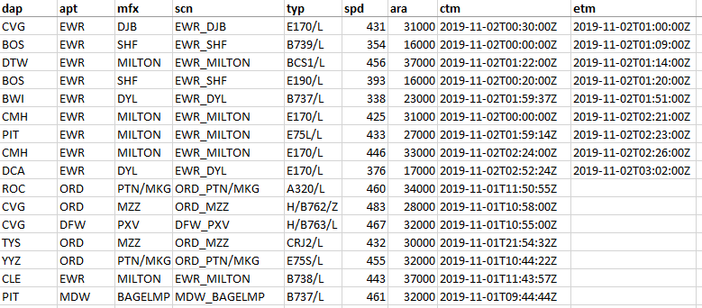
Data Understanding - Description
In addition to the elements earlier, the following TBFM SWIM data elements were used:
  “ctm” – Coordination time. In our case for departures, that is TBFM’s expected departure time from the airport.
  “etm” – EDCT time, if it has one. We translated this into a yes/no hasEDCT boolean feature.
  “scnname” – TBFM “con” message - Stream class name that is used with ssd (below) to determine MIT
  “ssd” – TBFM “con” message – Super Stream Class distance
Important note is the “scnname” and “ssd” from TBFM “con” gives the MIT separation for this flight
  This needs to be synchronized/matched with the “air” messages, and becomes a new feature in our dataset
25 MIT over LGA_DYL
Features from “air” messages
Derived feature from “con” messages
Data Understanding
Notes:
1:49

Slide 19
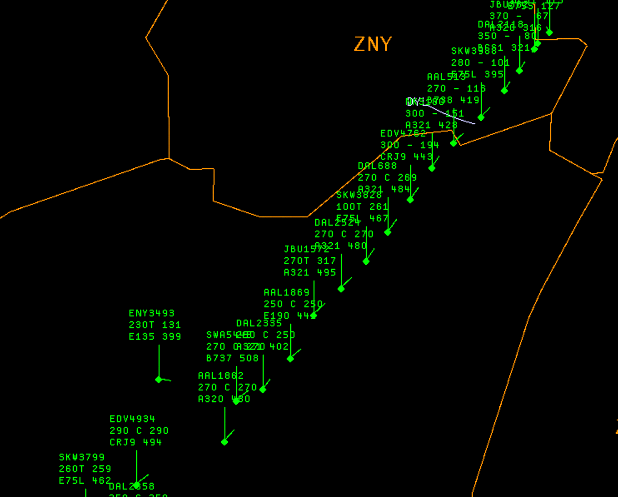
Importance of Super Stream Classes in TBFM
LGA_DYL super stream class in TBFM is among the busiest in the county
LGA_DYL Metering Arc
Super stream classes have been adapted across the country in TBFM instances.
They define how flights are grouped coming out of, and leading into airports. Often, a MIT separation is used at these points to regulate the flow of traffic into important airspace/airport locations.
Data Understanding
Notes:
1:53

Slide 20
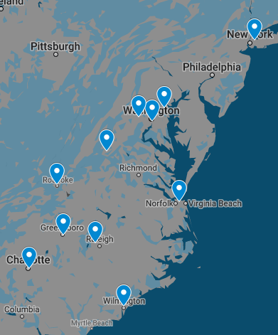
Goldilocks Zone – Close in Airports are Hot- Have Higher Delay
Estimated 90th Percentile delay by Origin into LGA_DYL for all of 2019
LGA Airport
Origin | 90th % Delay (min) | Number Apreqs | Distance (nm)
BWI | 39 | 89 | 132.6
DCA | 26 | 5717 | 164.9
IAD | 33 | 1110 | 188.4
RIC | 22 | 2738 | 213.9
CHO | 18 | 1316 | 253.9
ORF | 17 | 2386 | 270.6
RDU | 17 | 4420 | 329.8
ROA | 12 | 288 | 347.0
GSO | 15 | 2155 | 389.6
ILM | 15 | 781 | 402.7
CLT | 8 | 5036 | 451.9
LGA_DYL Metering Arc
Better
32 minute delays (90th %)
18 minute delays (90th %)
12 minute delays (90th %)
17 minute delays (90th %)
16 minute delays (90th %)
8 minute delays (90th %)
15 minute delays (90th %)
Data Understanding
Notes:
4:20

Slide 21
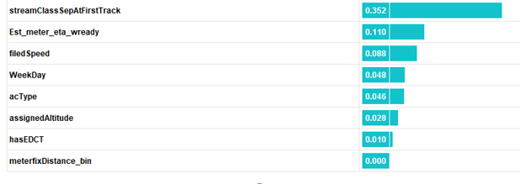
Feature Importance and Analytical Lessons
Feature Importance
Stream class separation (from SWIM)
ETA to metering arc (derived)
Filed speed (from SWIM)
Day of Week (derived)
Aircraft Type (from SWIM)
Assigned Altitude (from SWIM)
Has EDCT Boolean (derived)
Meter Fix Distance (derived)
Approx. 20 features (not shown here) were developed to achieve greater predictability of TBFM delay
  The results of this model yielded an overall accuracy of around 6.5 min error and 6.8 min standard deviation
  Site specific (city pair) predictive accuracy can be as good as 3 min (error and standard deviation) or as high at 10 min
  The machine learning regressor improved these predictions by 10-20% over any one statistical view
Important lessons learned were:
  Analysis of this problem benefits from grouping origin, destination and TBFM stream class name
  The MIT in use (super stream class separation) is the most important attribute with predictive power/lift
  Another important attribute is “what time of day do you need the stream class resource” (15 minute bin)
Feature Engineering & Model Fitting
Notes:
6:51

Slide 22

Questions Before Proceeding to ML Deployment
Identify Operational Goal
Select Initial Data Sources
Evaluation of Model Performance
Data Pre-processing
Deployment to Real-time System
SME
Analyst
Data Understanding
Model Validation
Feature Engineering & Model Fitting
Questions before proceeding to model deployment
Questions to community before proceeding:
  Is a model that lets users know the predicted size and variance of TBFM assigned delay (by city pairs and stream class) valuable to the community even if the standard deviation is extremely large (e.g. 10 minutes)? Or do the predictions need to be more accurate (lower std) to be usable?
  Can the community use data like that shown in this process to create a science/evidence-based definition of the “high TBFM delay” problem to help us focus our resources on the right problem?
Notes:
3:36

Slide 23
Summary
The aviation industries biggest barrier to more fully benefitting from ML is constructing our problems in the right format to take advantage of ML breakthroughs that already exist (and are growing every day). This includes
  Create an operationally meaningful problem as a ML challenge
  Comporting our data into clean datasets with solid “ground truth” data
  Creating initial benchmarks that ML experts can beat
Can we predict the likely landing runway with high certainty? If so, how good are the predictions?
  Yes, initial indications are very promising. The current day TBFM arrival runway prediction in this example was on the order of 70% accurate, whereas the gradient boost machine learning models achieve close to 90% accuracy. This is a significant improvement.
Can models developed with machine learning be deployed and leveraged in near real-time?
  Yes. In this example we deployed the model that was trained in post ops and leveraged it in a web service. Once the model is deployed as a service, near real-time data can be used to call it and get results from the model predictions.
More specificity is needed from the community on the “high TBFM delay” operational problem mentioned in prior SWIFT meetings
  This will help evidence-based solutions and can also be used to measure the benefits
These problems would benefit from more frequent engagement by the aviation analytical community to prevent stovepipe solutions, ensure truth in reporting and leverage lessons learned across teams
Notes:
Total takes 78.4 minutes without questions
4:24
2nd part takes 1537 seconds (25.6 min)
Total presentation takes

